Slide 1

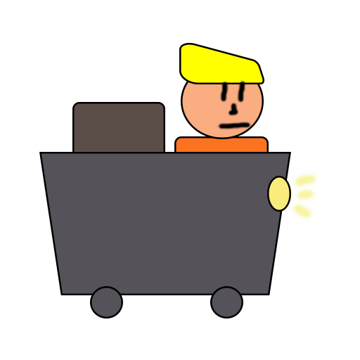
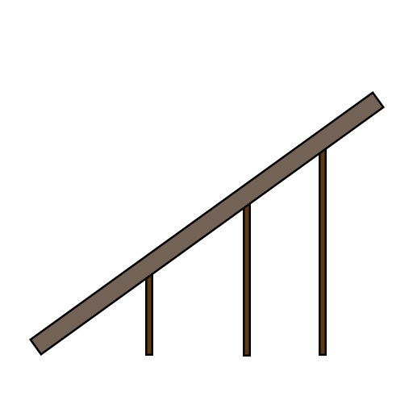
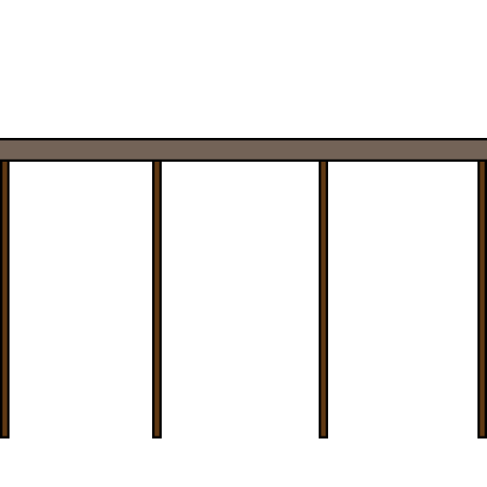
Minecart
Andrei Dumbravescu
Alpeche Pancha
Matthew Fisher

Slide 2
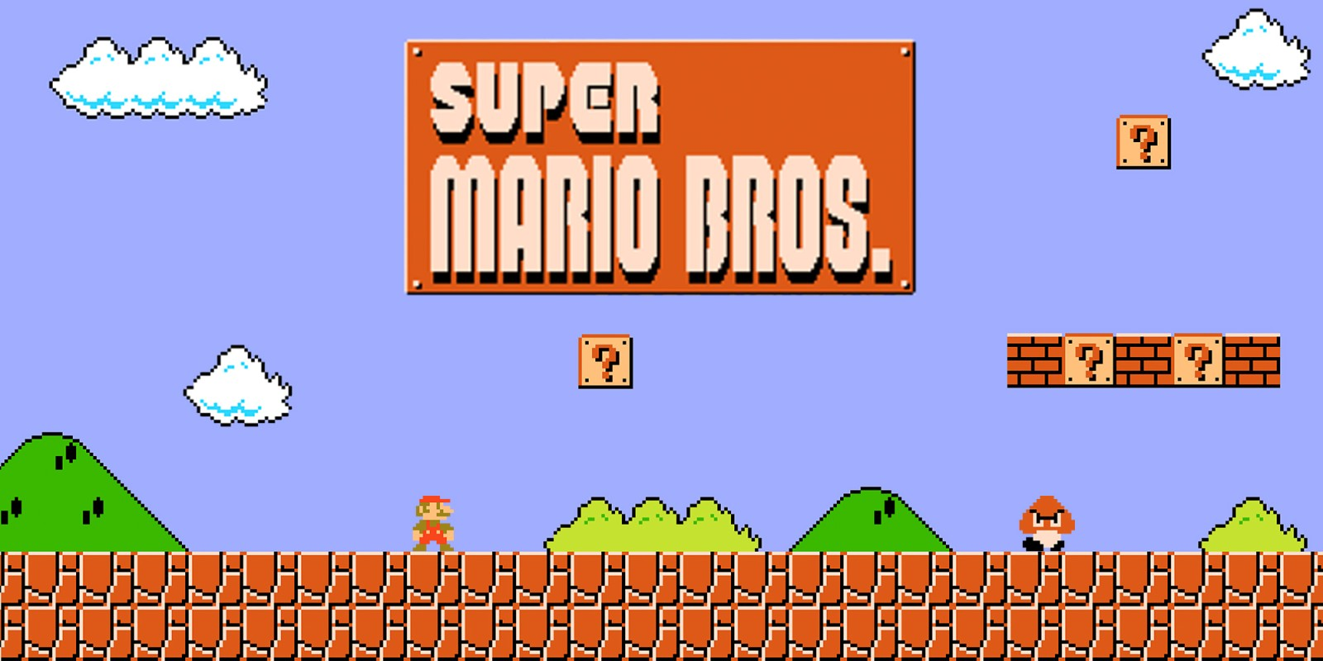

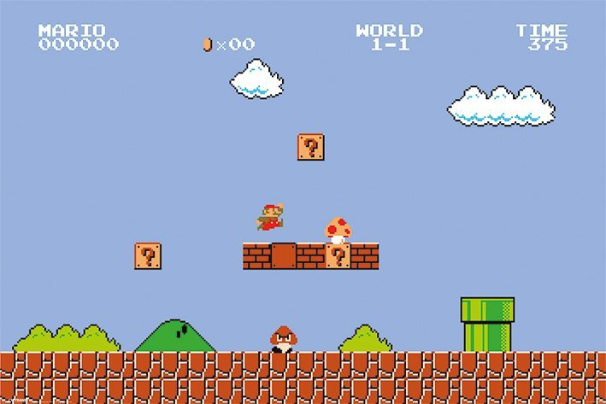
Project Key Points
2D Platformer
Replacing the Jump Mechanic

Slide 3
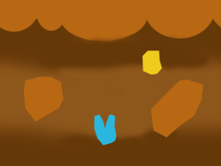
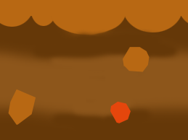
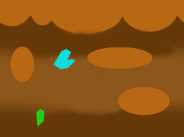

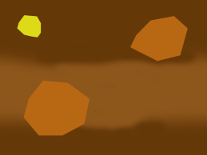
Brief Response
Changing to a Drag and Drop Mechanic
Player Character moves at a constant speed
Endless random generated level

Slide 4

Emotions
Fiero!
Building tension through constant need of fast reactions and unknowable upcoming obstacles
Release through the inevitable player death

Slide 5
Motivation
Distance tracker
Currency tracker

Slide 6

Upcoming
Random generated assets in the level
UI assets that improve the user experience
Menu screen, pause screen and end screen
Audio
Animations
Visual effects

Slide 7

Questions?

